Slide 1
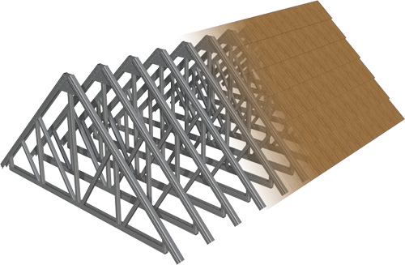
DESIGN OF TRUSS ROOF
Chapter 7
University of Engineering & Technology, Taxila

Slide 2
PANEL LOADS
Concentrated load applied at the interior panel point of the truss in kN is called Panel Load (P).
It is calculated by multiplying the roof load (load per unit area) by the horizontal area of the roof contributing load to interior panel point of the truss.
It is separately calculated for dead, live and wind loads.

Slide 3
The truss is analyzed for unit gravity loads, unit wind force on left side of truss and unit wind force on the right side of the truss.
Principle of superposition is then used to calculate member forces due to actual loads.
Suppose that the deflection at any point of the truss, called point A, due to unit load acting at some other point B of the truss is Δ.

Slide 4
According to the principle of superposition, for structures within elastic range, the deflection of the structure due to combined action of two sets of loadings is equal to the sum of deflections due to individual loads acting separately.
If another unit load is applied at A, deflection at point B will become ∆ +∆ or 2∆.
Similarly for P number of unit point loads, the deflection will be P x ∆.

Slide 5
The same principle is also valid for member forces.
Panel load multiplied with the unit load member forces gives the magnitudes of member forces for the actual loads.
This explains the use of calculating the panel loads for dead, live and wind loads.

Slide 6
Load at interior
panel point = P = load intensity over horizontal plan area (w)
x area supported by the panel point (p x s)
= w x p x s
Load at exterior panel point = P/ 2

Slide 7
However, the exterior panel load needs not to be calculated as the truss may be analyzed for unit load on interior panel points and half load on exterior panel points.

Slide 8
Truss T-2
s
Truss T-1
p

Slide 9
a) Elevation of Truss
Area contributing load
at one interior panel
Point = p x s
p
p
s/2
s/2
b) Part-Plan of
Truss Roof
s
p/2
p/2
P= panel length in a horizontal plane
S= center-to-center spacing of trusses

Slide 16
s
p

Slide 17
How much area is contributing load
here as point load
p
s

Slide 18
p
s

Slide 19
s
p
p
s

Slide 20
p
s

Slide 21
UDL (w) acting over the panel area

Slide 22
UDL (w) N/m² is converted
Into Panel concentrated load
P= w x s x p

Slide 23
UDL (w_{D}) N/m² is converted
Into Panel concentrated load
P_{D}= w_{D} x s x p

Slide 24
UDL (w_{L}) N/m² is converted
Into Panel concentrated load
P_{L}= w_{L} x s x p

Slide 25
How much area is contributing load
here as point load
s
p
p
s

Slide 26
p/2
s

Slide 27
UDL (w) acting over the half panel area
s
p/2

Slide 28
UDL (w) N/m² is converted
into Panel concentrated load
P= w x s x p/2

Slide 29
s
p
θ

Slide 30
p/cosθ
UDL (w_{w}) N/m² is converted
Into Panel concentrated load
P_{ww}= w_{w} x s x p/cosθ
θ
p
θ

Slide 34
Example 7.1:
Find panel loads for the given truss data.
Data:
Angle of top chord = 30 ⁰
Dead load of roofing = 17 kg/m²
Insulation boards = 5 kg/m²
Self weight of purlins = 10 kg/m²
Self weight of bracing elements = 3 kg/m²
Miscellaneous = 5 kg/m²
Panel Length, p = 2.5 m
Span length of truss, L = 20 m
Spacing of trusses, center-to-center, S = 5.5 m

Slide 35
Solution:
Total dead load except truss self weight = sum of given dead loads
= 40 kg/m²
Live load, from Design Aids, for θ = 30⁰ = 60 kg/m²
Total gravity load, w = 40 + 60
= 100 kg/m²

Slide 36
Using Thayer’s formula
Self weight of truss =
12.2 kg/m²
Total dead load = 40 + 12.2
= 52.2 kg/m²

Slide 37
Leeward wind pressure = 1250(-0.7) = -875 N/m²
Windward wind pressure = 1250(-0.9) = -1125 N/m²
and 1250 (0.3) = 375 N/m²
Penal dead load, P_{D} = w x p x S
= 52.22 x 2.5 x 5.5 x 9.81/ 1000 = 7.04 kN
Panel live load, P_{L} = 60 x 2.5 x 5.5 x 9.81 / 1000
= 8.09 kN

Slide 38
The wind load is acting perpendicular to the inclined roof surface and hence actual inclined roof area is to be used to calculate the panel loads.
This can be done by using the inclined panel length (p/cosθ) in the expression for calculation of the panel loads.

Slide 39
Panel wind load on leeward side, P_{wl}
=
= - 13.89 kN (upward)
Panel wind load on windward side, P_{ww}
=
= -17.86 kN

Slide 40
And
=
= 5.95 kN

Slide 41
?

Slide 42
Assignment:
Find the panel loads for your truss.
Time Allowed: 1 week

